Slide 1

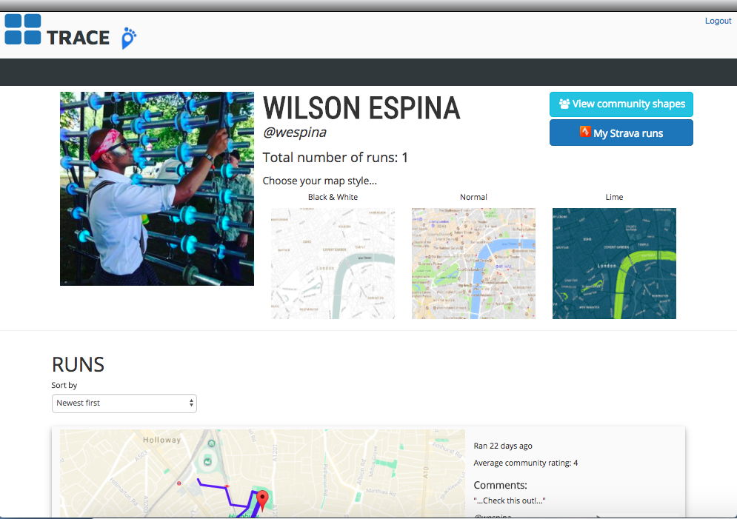
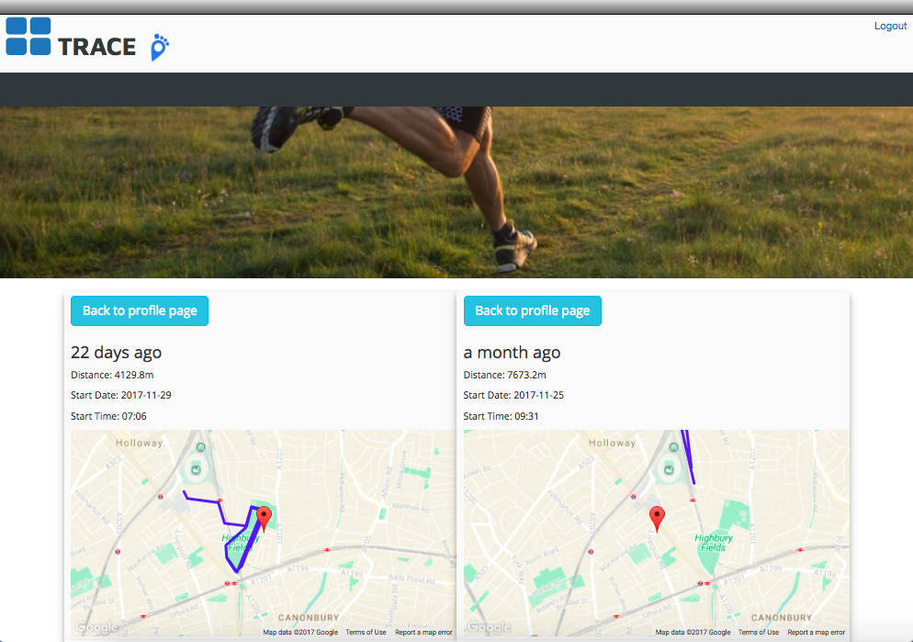
LANDING PAGE
USERS INDEX PAGE
PROFILE PAGE

